Slide 1
Indian Domestic Flights Analysis
A Data-Driven Report on Pricing & Airline Efficiency
Pradyumn singh
July 28, 2025

Slide 2
Project Overview
Project Objective:
To clean, analyze, and visualize a dataset of over 300,000 domestic Indian flights to uncover key insights into airline pricing, route popularity, and operational efficiency.
Core Business Questions:
Pricing & Competitiveness:
What are the key drivers of flight prices, and how do airlines compare?
Route & Efficiency:
What are the busiest routes, and which airlines are the most time-efficient?

Slide 3
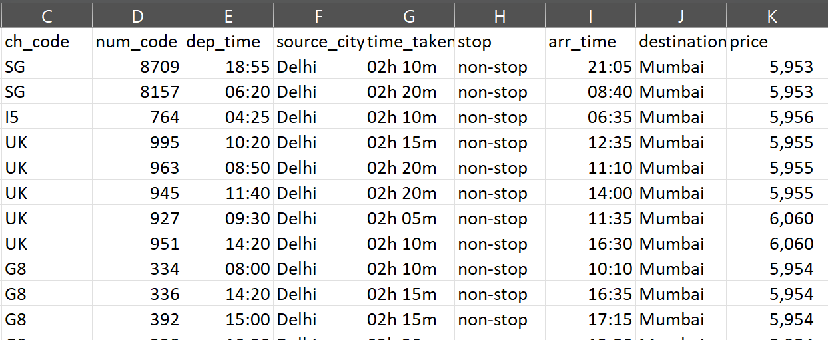
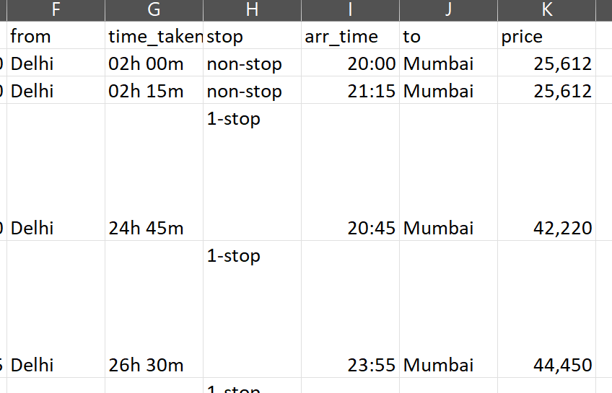
Initial Data Assessment
RAW DATA
C:\Users\Pradyumn Singh\Desktop\databases\airline
The analysis began with two separate, raw datasets for Economy and Business class flights.
The data was unstructured and not suitable for direct analysis, containing messy text, inconsistent formats, and missing values.

Slide 4
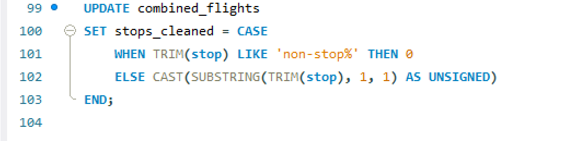
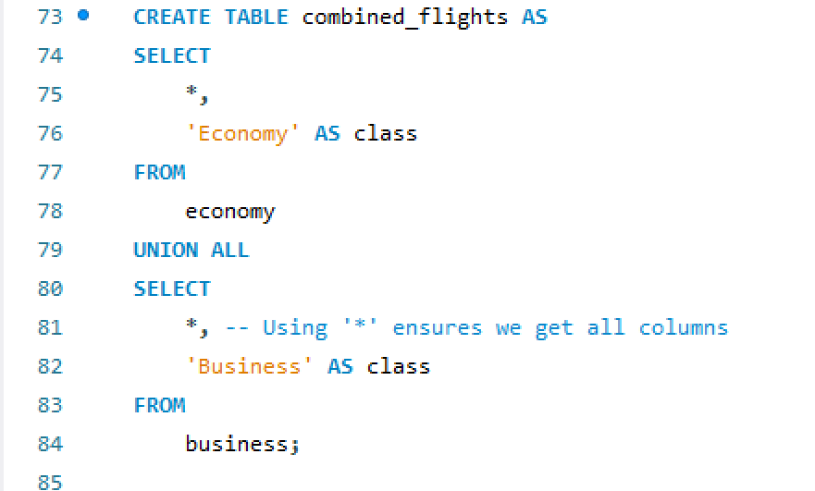
The SQL Data Cleaning Process
Combine Datasets:
Used UNION ALL to merge the economy and business tables into a single master table (combined_flights), creating a new class column to maintain the distinction.
Clean price Column:
Used REPLACE, TRIM, and CAST to remove commas and spaces and convert the price from text to a numeric data type.

Slide 5
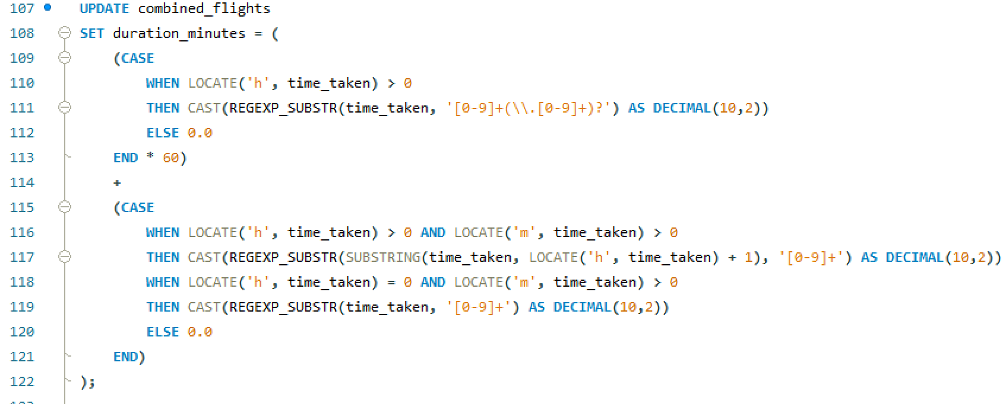
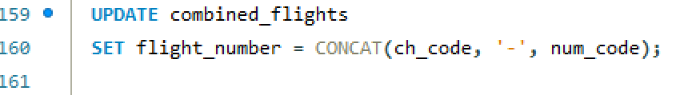

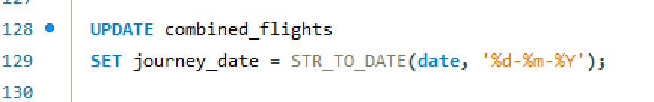
Clean stop Column:
Used a robust CASE statement to convert varied text formats (e.g., "non-stop", "1-stop", "2+ stops") into clean integers (0, 1, 2).
Clean time_taken Column:
Implemented an advanced query using REGEXP_SUBSTR to parse complex text (e.g., "2h 50m", "1.03h") and calculate a single, clean duration_minutes value.
Clean Date/Time Columns:
Used STR_TO_DATE and CAST to convert text-based dates and times into proper DATE and TIME formats for analysis.
Feature Engineering:
Created a new flight_number column by concatenating ch_code and num_code.

Slide 6
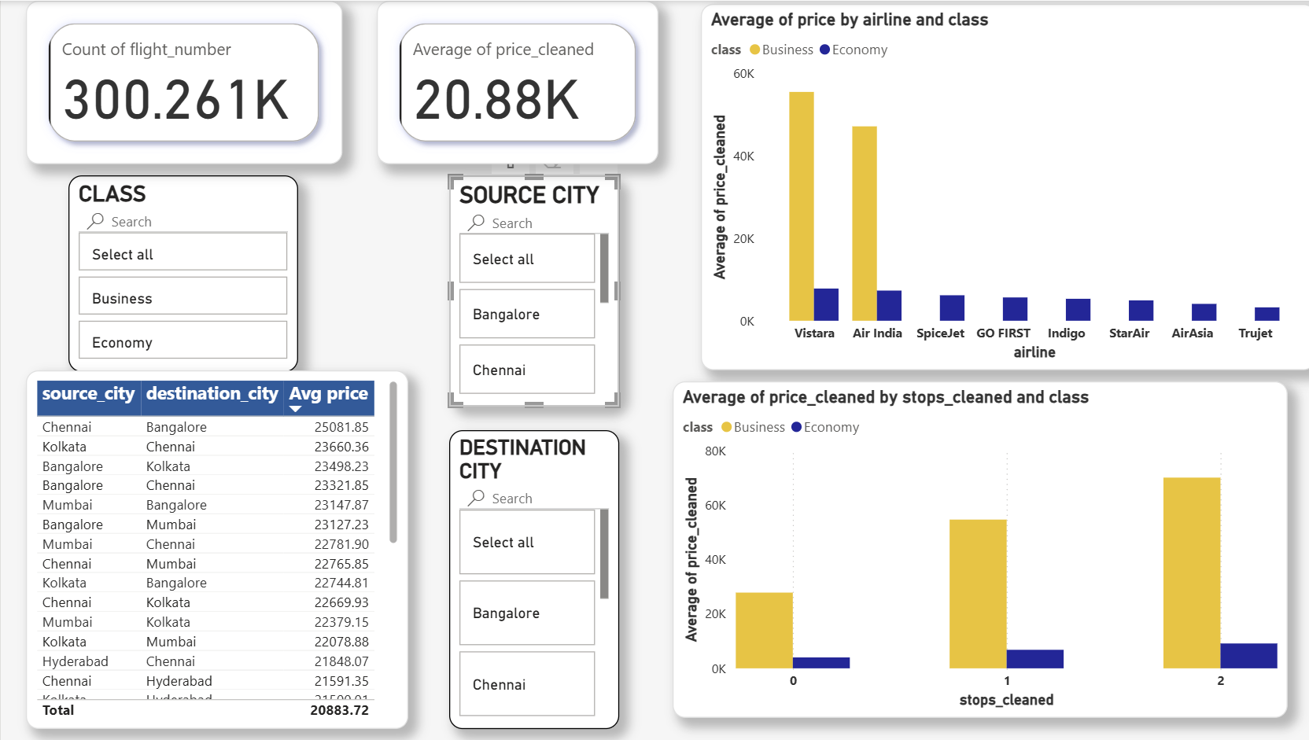

Slide 7
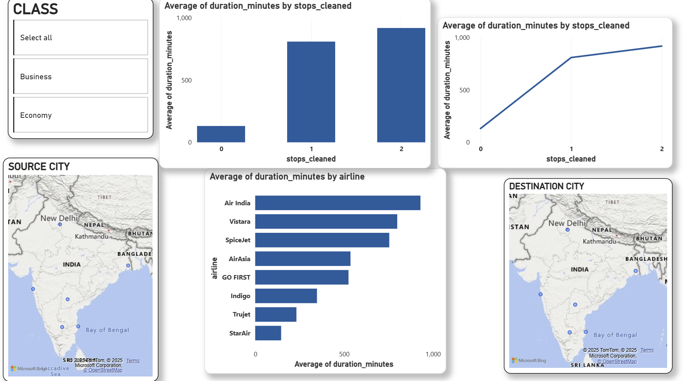

Slide 8
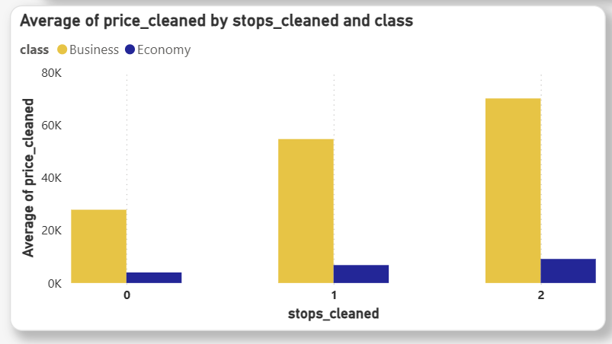
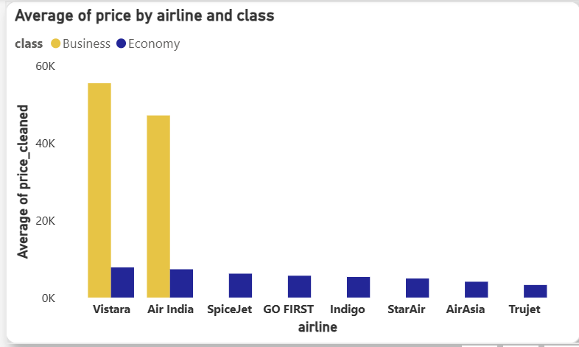
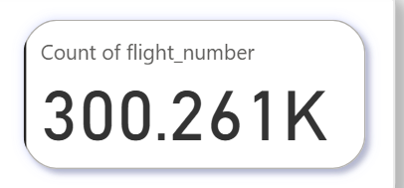
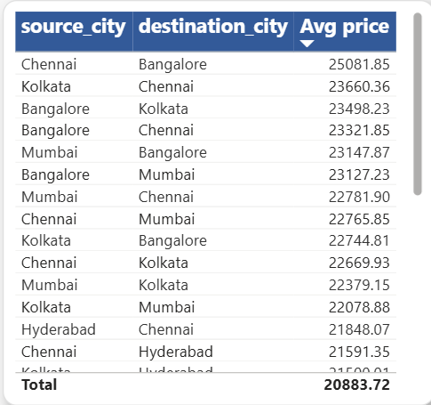
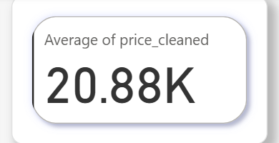
Analysis 1: Pricing & Airline Competitiveness
Key Findings:
Class is the #1 Factor:
A significant price gap exists between Economy and Business class, with Vistara and Air India dominating the premium market.

Slide 9
2. Stops Add Predictable Cost:
Each additional stop significantly increases the ticket price for both classes in a clear, step-like pattern.
3. Metro Routes Command Premium Prices:
The most expensive routes are consistently between major metro hubs (Delhi, Mumbai, Bangalore, etc.), regardless of the airline.
Recommendations:
For Travelers:
The most effective way to find a cheap flight is to book a non-stop, economy ticket on a budget airline like Trujet or AirAsia.
2. For Airlines:
Price points are well-defined. Budget carriers should focus on maintaining their low-cost advantage on high-volume routes, while premium carriers must justify their higher cost through superior service.

Slide 10
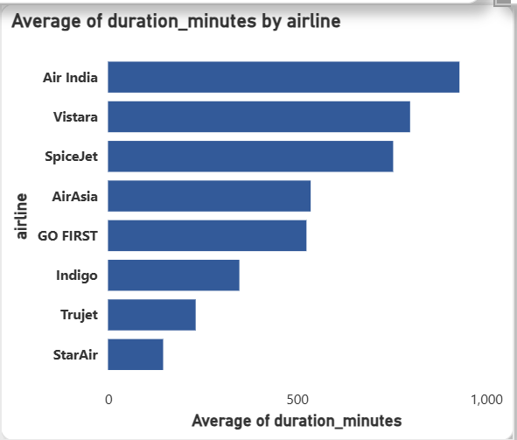
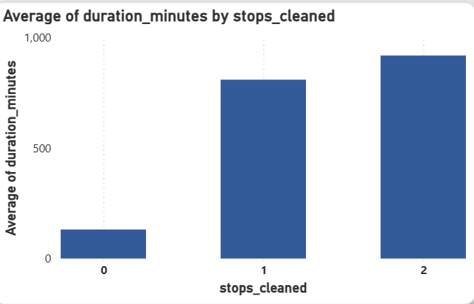
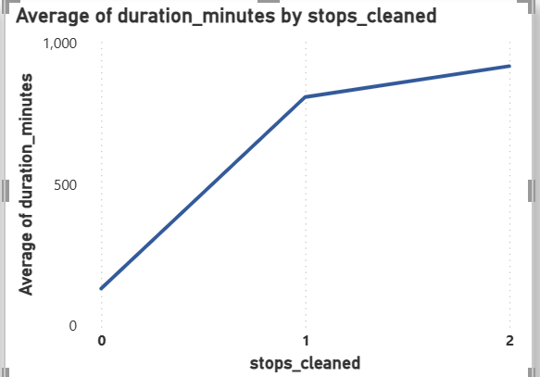
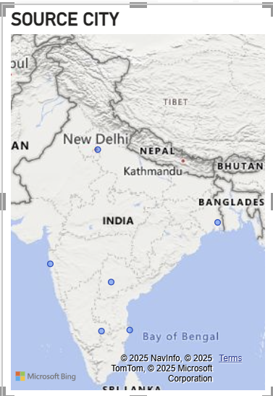
Analysis 2: Route & Flight Efficiency
Key Findings:
1. Air Travel is Highly Concentrated:
The vast majority of domestic flights operate between the major metro cities, with Delhi -> Mumbai being the busiest corridor.

Slide 11
2. Direct Flight Times are Nearly Identical:
When comparing non-stop flights on the same route, all airlines have almost the same flight duration. There is no significant "fastest" airline in the air.
3. The Real Differentiator is Availability:
The analysis revealed that the key difference between airlines is not their speed, but their schedule—specifically, which airlines offer the most non-stop options on the busiest routes.
Recommendations:
1. For Travelers:
When choosing a direct flight, the decision should be based on price and schedule convenience, not on which airline is perceived to be "faster.“
2.For Airlines:
The competitive advantage on high-traffic routes comes from offering a greater frequency of non-stop flights at convenient times, not from marginal gains in flight speed.

Slide 12
Final Conclusion & Strategic Imperative
Central Finding:
The Indian domestic flight market is highly structured and predictable. Price is determined by a clear hierarchy of Class > Stops > Route. On major routes, airlines compete on price and schedule availability, not on in-air flight time.
Strategic Imperative:
Success in this market requires a clear strategy. Budget airlines must focus on operational efficiency to maintain their price advantage, while premium airlines must focus on the on-ground and in-cabin service to justify their higher price point, as speed is not a differentiating factor.

Slide 13
Thank You

